Slide 1

Bioinformatic approaches to regulatory genomics and epigenomics
376-​1347-00L | week 06
Pierre-Luc Germain

Slide 2
Plan
New packages to install (see slack)
Debriefing on last week’s assignment
Overview of transcription factors and their binding specificity
DNA motifs and related analysis

Slide 3
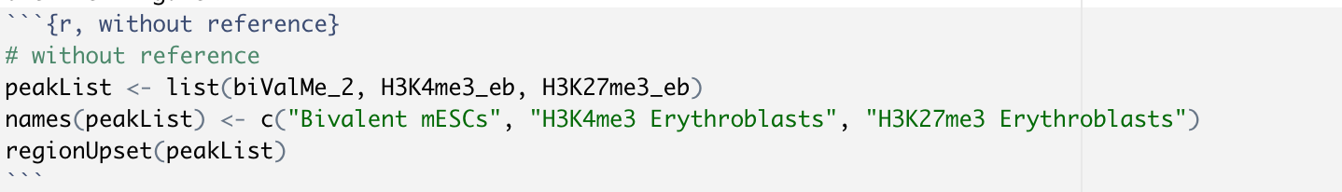
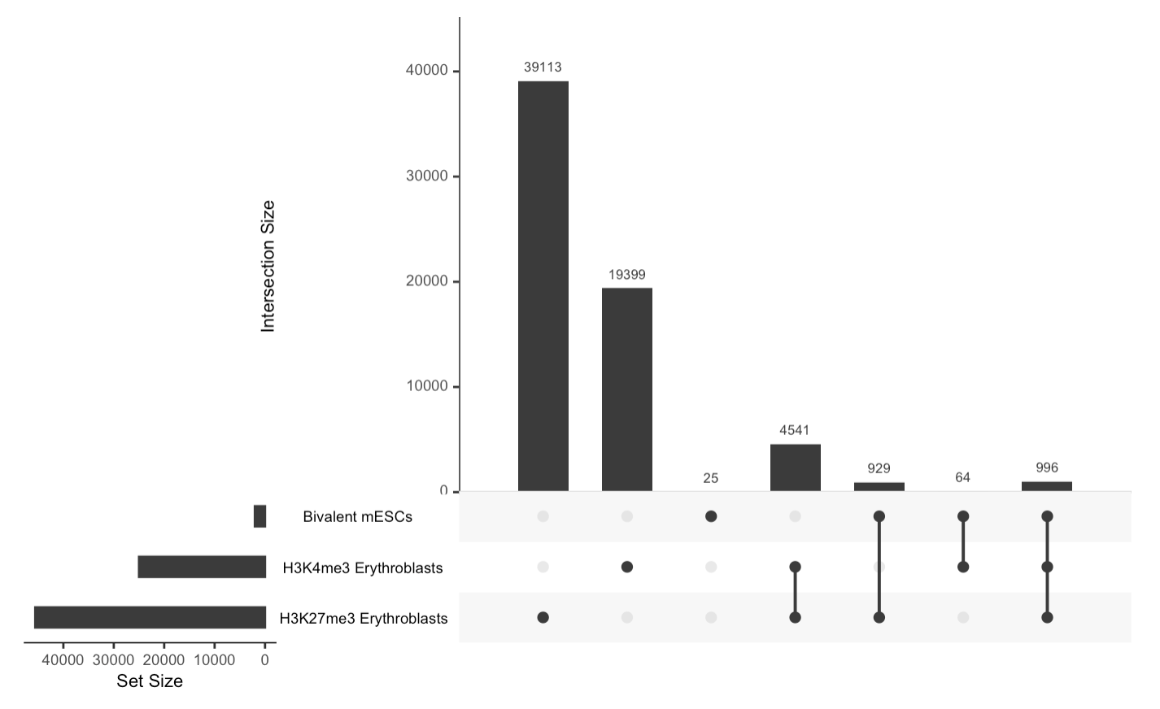
Debriefing on the assignments
Using references for upset plot

Slide 4
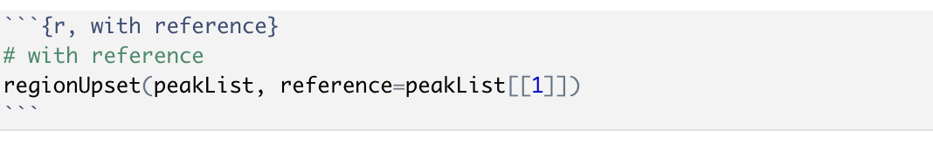
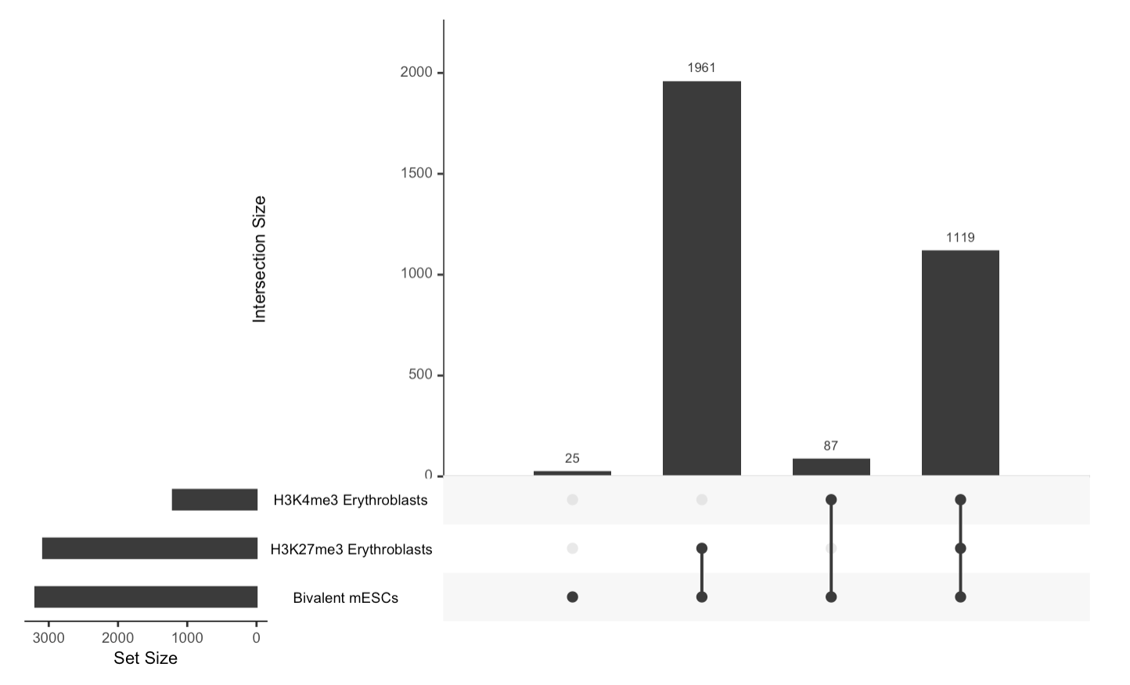
Debriefing on the assignments
Using references for upset plot

Slide 5
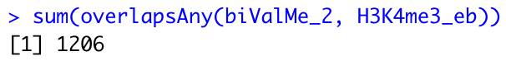
Debriefing on the assignments
Using references for upset plot
=87+1119

Slide 6
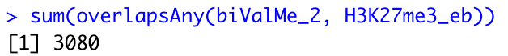
Debriefing on the assignments
Using references for upset plot
=1916+1119

Slide 7
Debriefing on the assignments
When no reference is specified, one is created automatically by merging and reducing the regions (unless otherwise specified in the arguments):
regions1
regions2
reduce(c(regions1, regions2))

Slide 8
Intersection & overlap:
The example of bivalent domains
H3K4me3:
H3K27me3:
method one (overlapsAny): find the H3K4me3 peaks that overlap a H3K27me3 domain
method two (intersect): find the regions that are covered by both H3K4me3 and H3K27me3

Slide 9
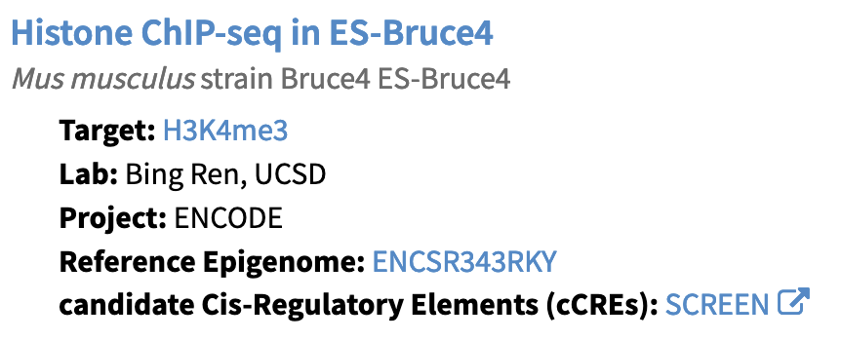
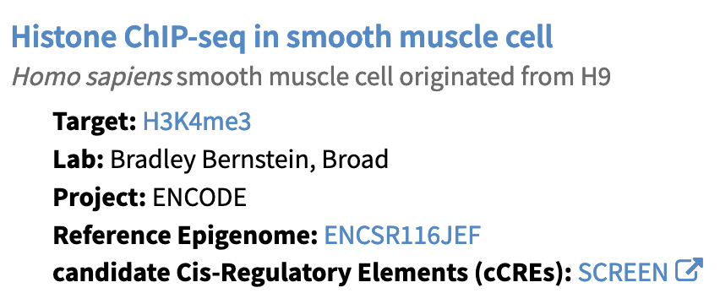
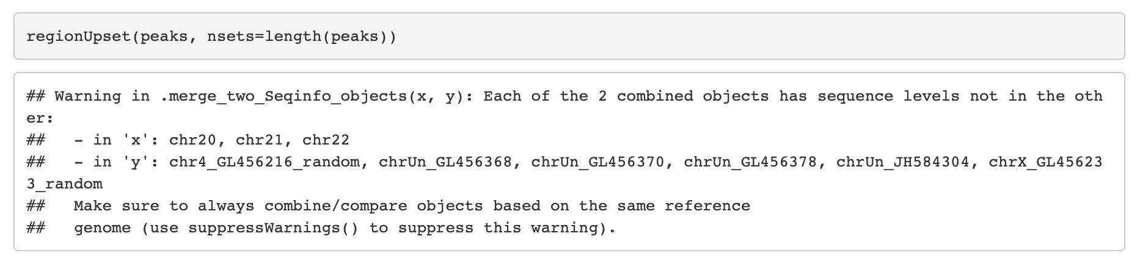
Debriefing on the assignments
Annotations:
ENCFF247GVM
ENCFF326VMV

Slide 10
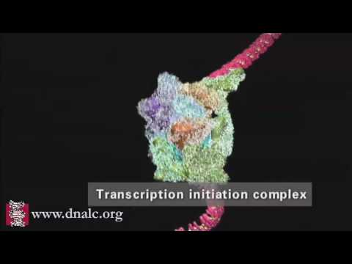
https://youtu.be/SMtWvDbfHLo
( See also https://youtu.be/WW9lIYM_FC0 )

Slide 11
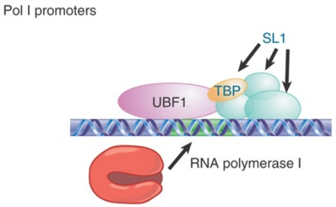
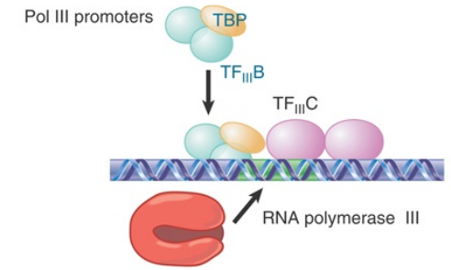
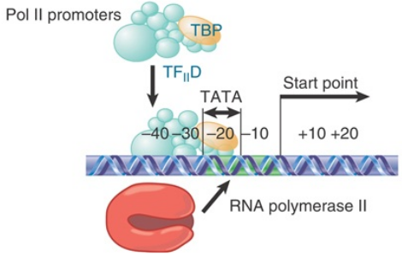
rRNA
tRNA
Most RNAs
(Adapted from Krebs, Goldstein and Kilpatrick, Genes XII, 2018)

Slide 12
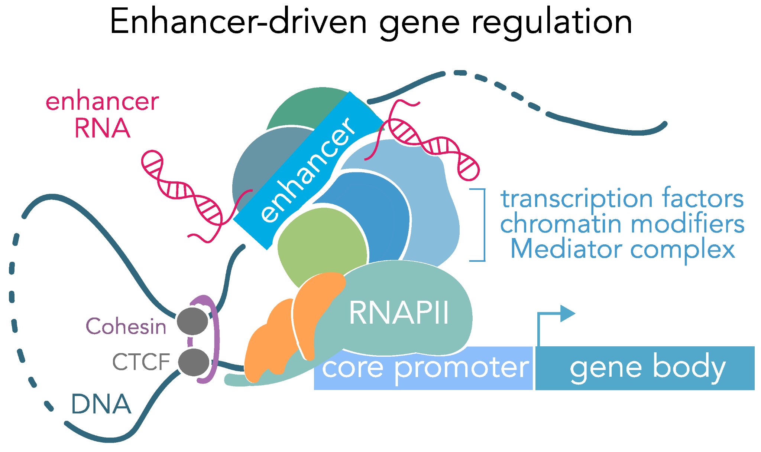
Additional regulatory elements
(Carullo and Day, Genes 2019)

Slide 13
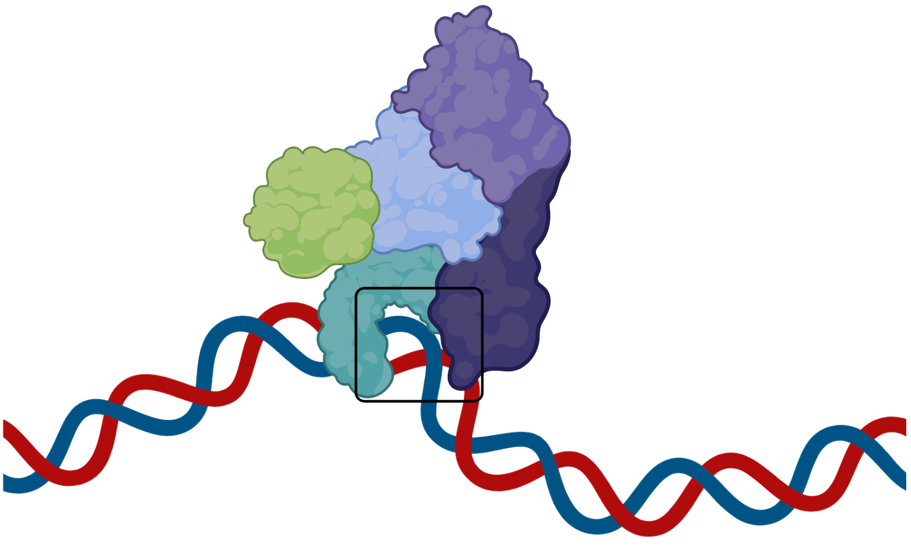
What is a transcription factor?
Not transcription factors
Proteins capable of both:
Binding DNA in a sequence-specific manner
Regulating transcription
(Lambert et al., Cell 2018)
Sequence-specific DNA binding
(biorender)
co-regulators /
co-factors
Transcription factors
Transcription regulators

Slide 14
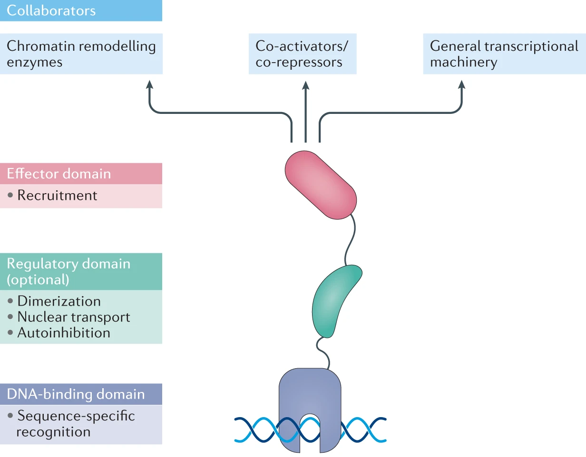
Anatomy
of a transcription
factor (TF)
(Henley & Koehler, NRDD 2021)

Slide 15
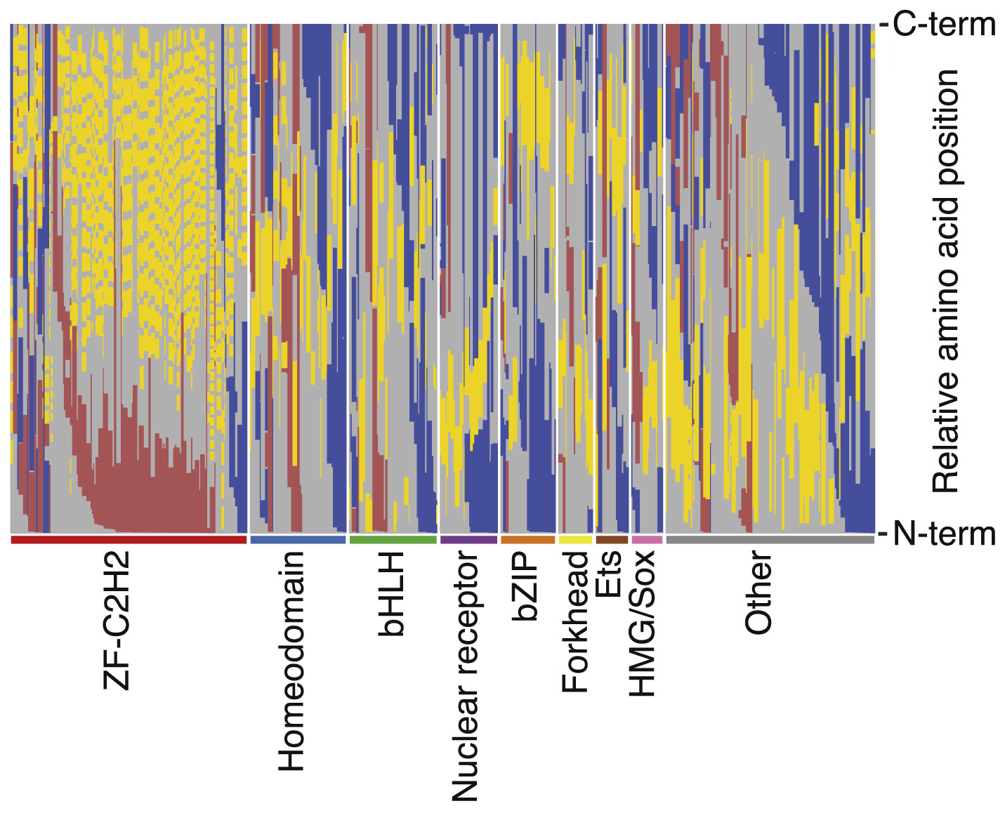
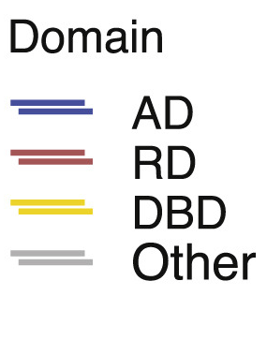
While most TF have either an activating (AD) or repressive (RD) domain, some have both
(Adapted from
Soto et al., Molecular Cell 2021)

Slide 16
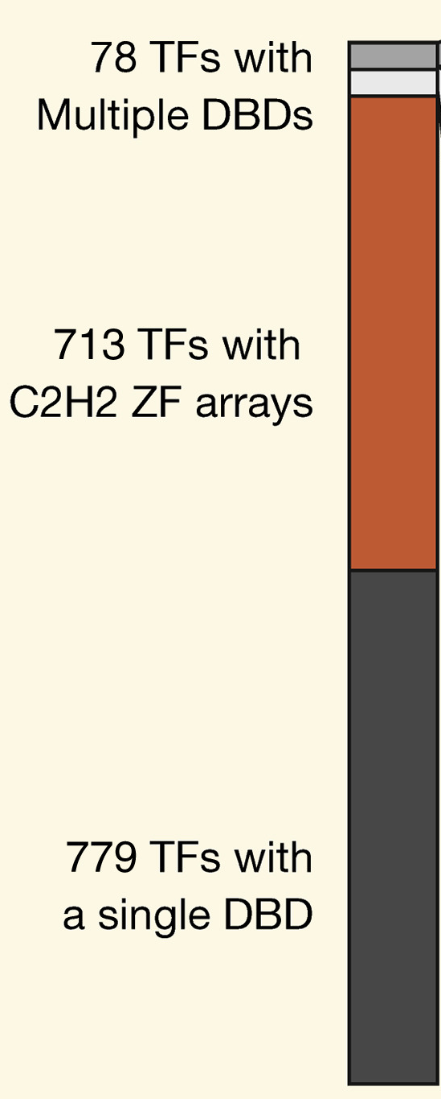
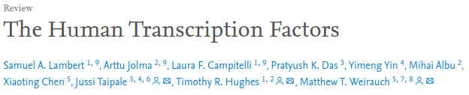
(Cell 2018)
Proteins capable of both:
Binding DNA in a sequence-specific manner
Regulating transcription
According to their census, humans have 1570 transcription factors

Slide 17
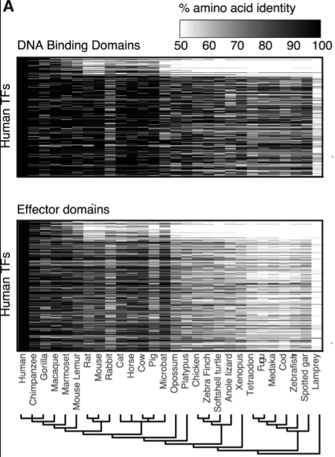
Transcription factors are highly conserved
DNA binding domains show much higher conservation than effector domains
(Soto et al.,
Molecular Cell 2021)

Slide 18
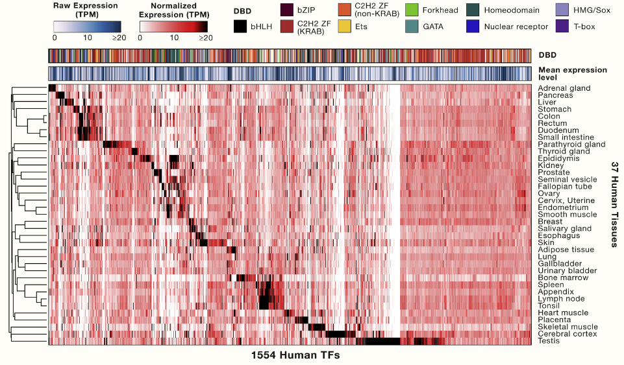
Homeodomain
TFs tend to be tissue-specific (82%)
ZFs (>80%) tend not to be
tissue-specific
(Lambert et al., Cell 2018)

Slide 19
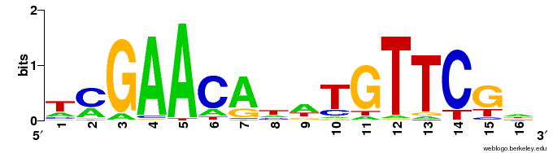
Sequence-specificity
E.g. The LexA bacterial TF recognizes the consensus sequence
5'-GAACAnnTGTTC-3'
-log2(p-value)

Slide 20
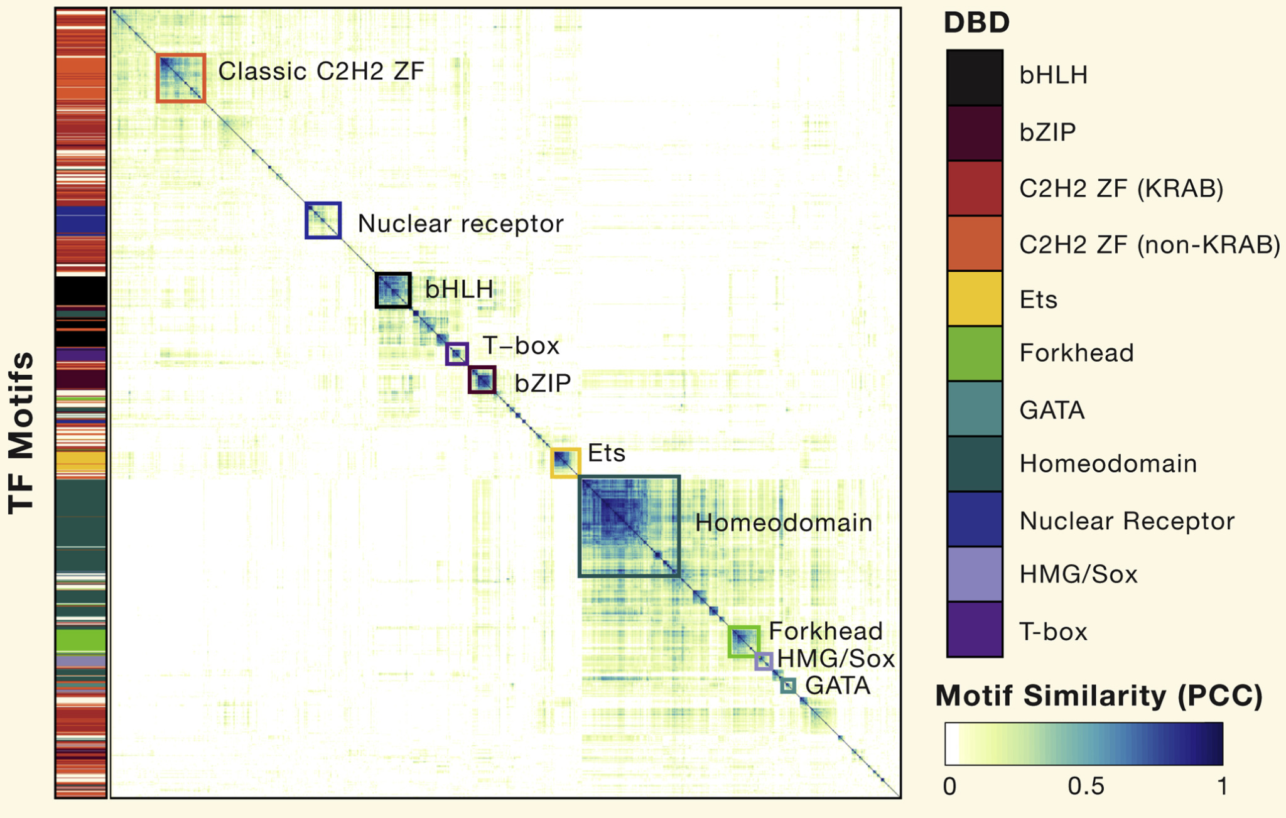
(Lambert et al.,
Cell 2018)

Slide 21
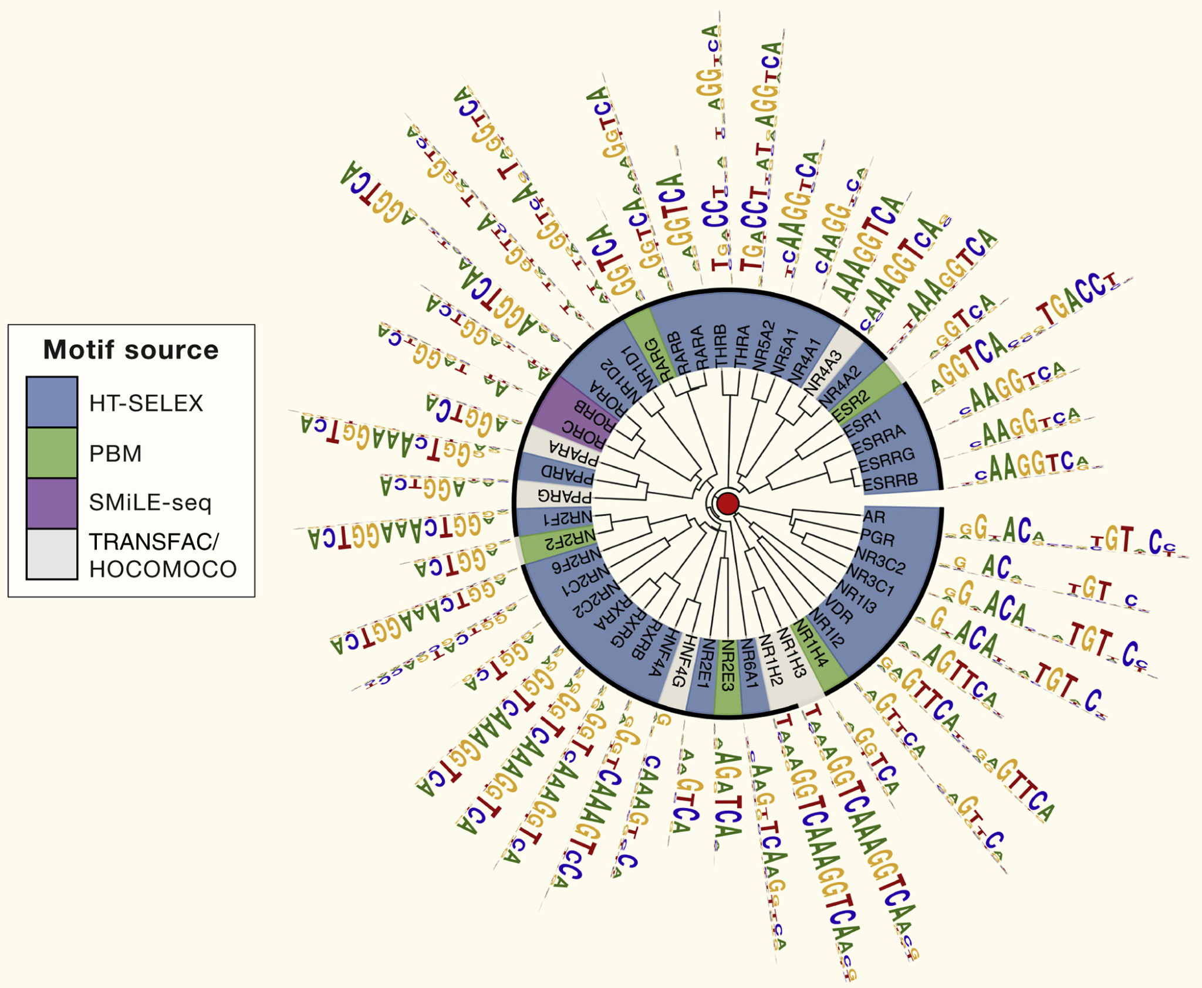
An example of TF motif degeneracy:
Nuclear hormone receptors
(Lambert et al., Cell 2018)

Slide 22
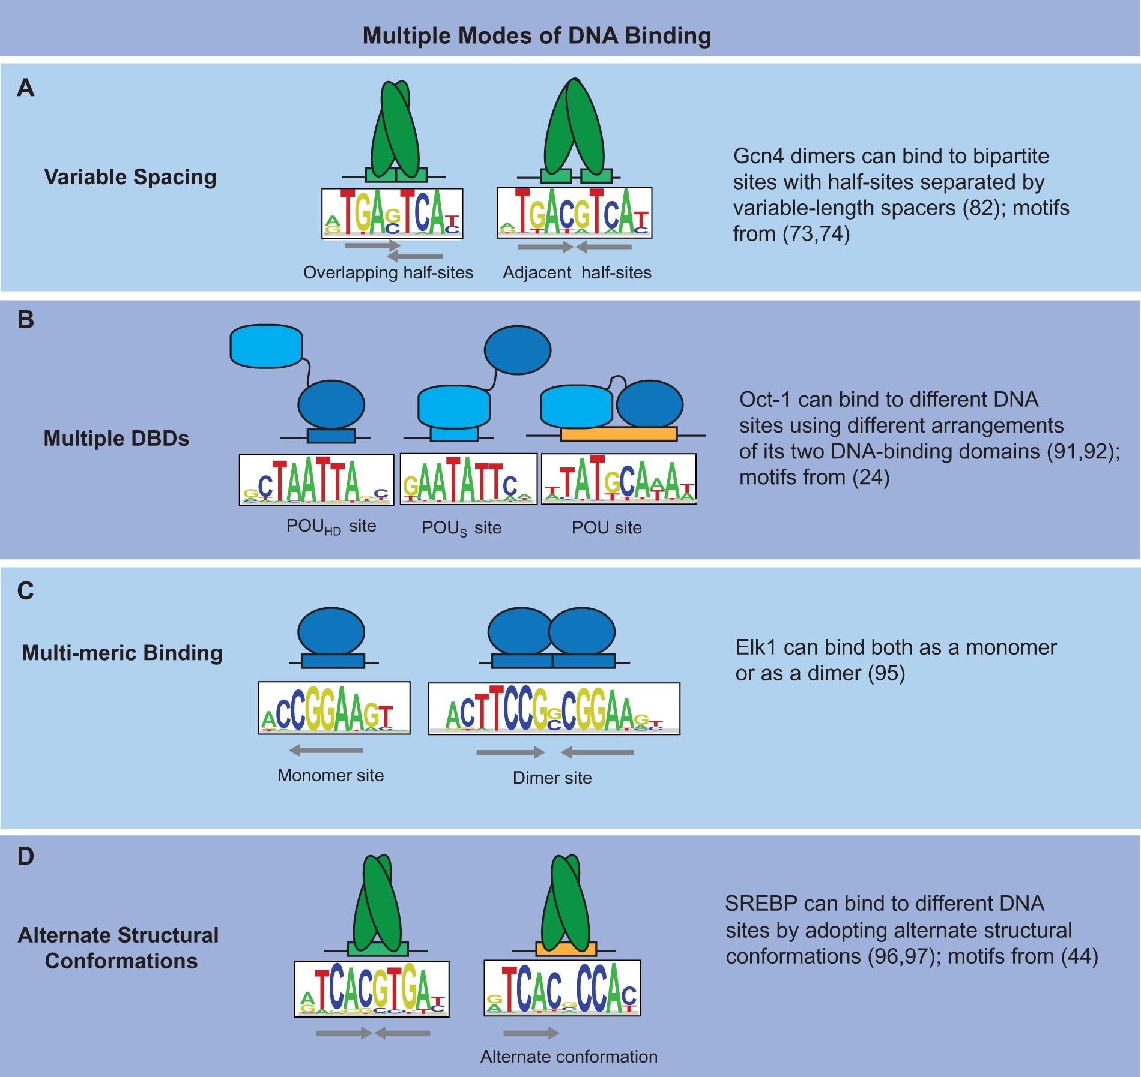
Variations in
DNA binding
specificity
(Siggers and Gordân, NAR 2014)

Slide 23
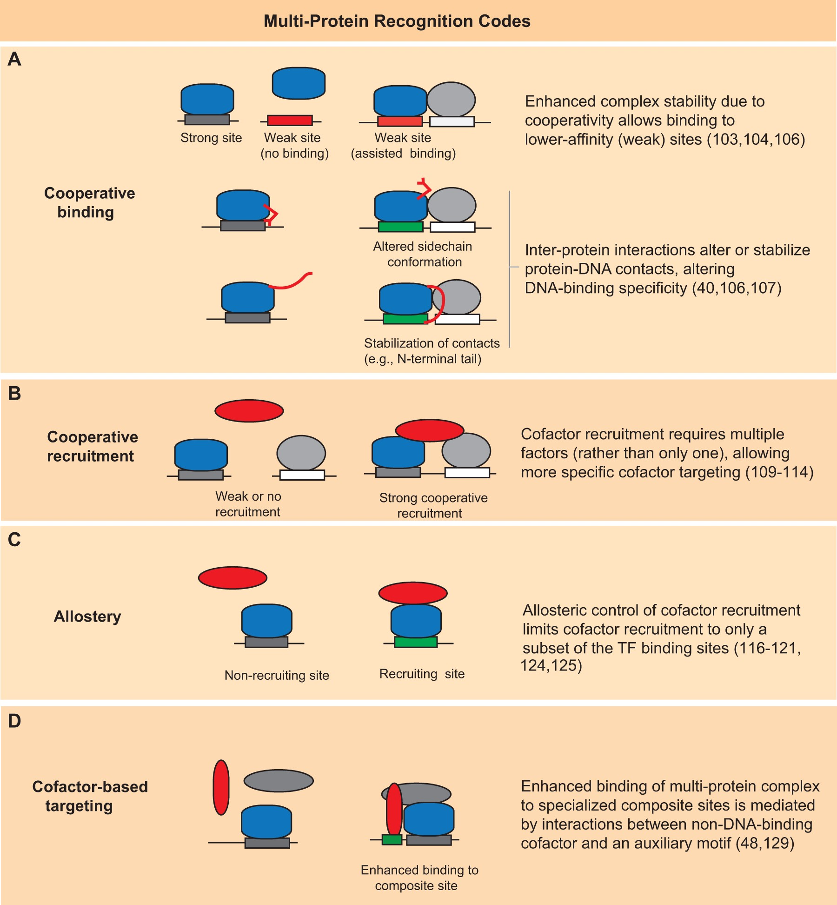
Cooperative binding
Highly combinatorial
binding of TFs
(Siggers and Gordân, NAR 2014)

Slide 24
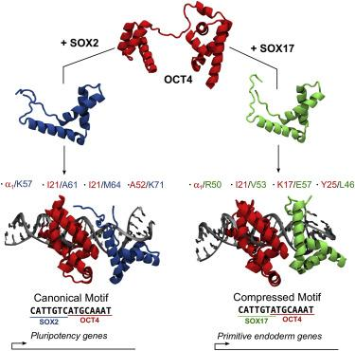
Two examples of Cooperative binding
OCT4 (POU5f1) binding
upon differentiation
(Merino et al., Structure 2014)

Slide 25
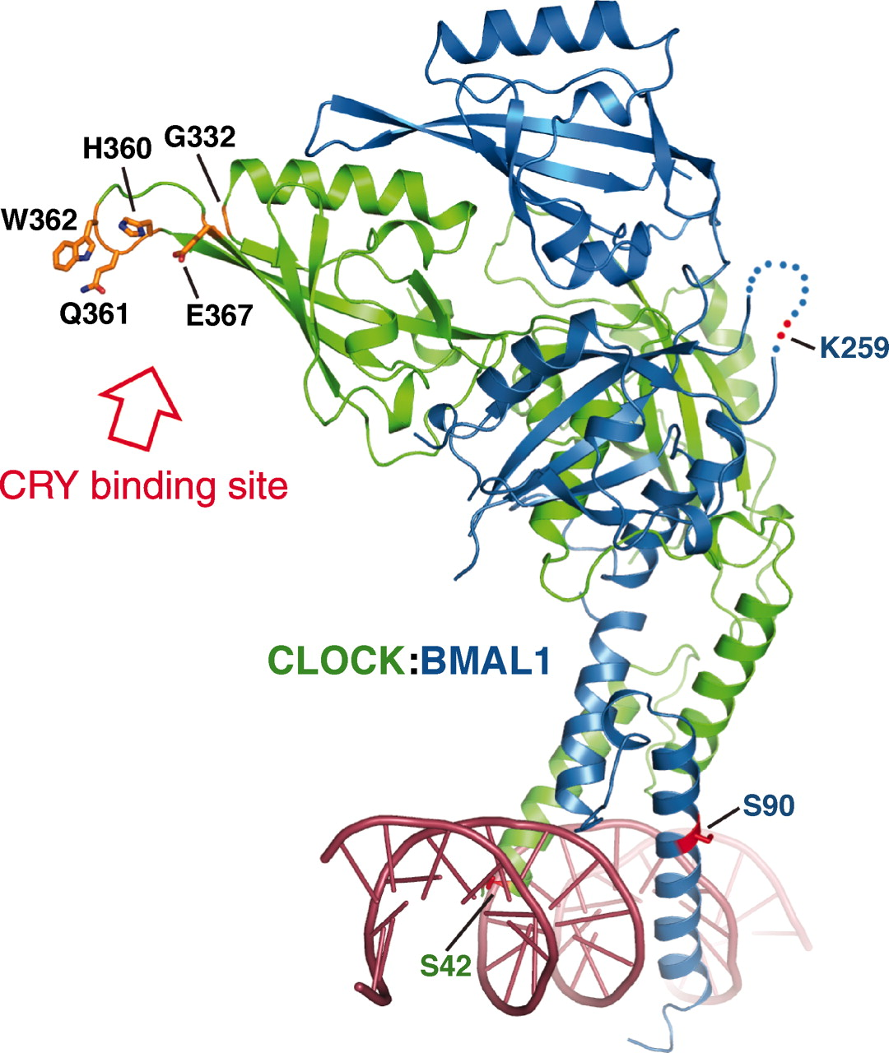
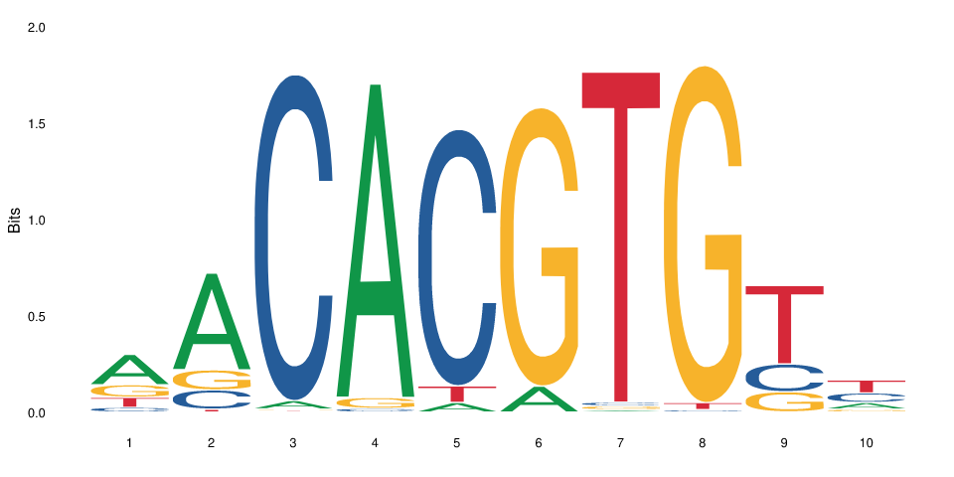
Clock-Bmal-Cry during
circadian rythm
(Huang et al., 2012)

Slide 26
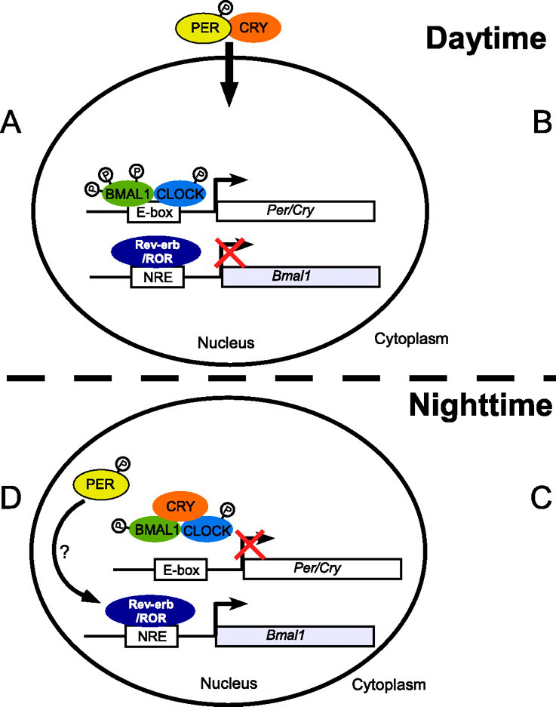
(Huang et al., 2012)
(Adapted from Ye et al., JBC 2011)

Slide 27
Motif analysis
Motif discovery aims at finding new motifs that are enriched in a set of sequences (e.g. peaks) versus a background
Example method: meme (Meme suite)
Bioconductor method: rGADEM package (see also the memes R package)
Motif enrichment analysis aims at finding known motifs that are enriched in a set of sequences (e.g. peaks) versus a background
Example method: AME (Meme suite)
Bioconductor method: PWMEnrich package
Motif scanning aims at finding the occurrences of known motifs in a set of sequences (methodologically fairly simple – which method doesn’t matter much)
Example method: fimo (Meme suite)
Bioconductor method: motifmatchr (see also TFBSTools package)

Slide 28
Genetic variation at TF binding sites
Genetic variation at TF binding sites can affect the binding of the protein, and hence impact development and health
Nevertheless, while most coding sequences show evidence of evolutionary constraint (e.g. purifying selection), only a small fraction of TF binding sites (11.6% of footprints) show evidence of constraint – the vast majority appears to be evolving neutrally
(Vierstra et al., Nature 2020)
This suggests a degree of (at least partial) redundancy between regulatory elements

Slide 29
Assignment
Choose a transcription factor, e.g. CREB1, REST, GATA5, EGR1, GCR (or any of your choice that has a motif and available ChIPseq data)
Download the (e.g. Mouse) peaks for that factor (whatever cell type)
Identify the instances of the factor’s motif
Answer the following questions:
Of all the peaks, what proportion contains a motif for the factor?
Expected form of an answer: of the XX peaks, XX (XX%) contain a motif
Of all instances of that motif in the genome (or in one chromosome), what proportion is bound by the factor (i.e. has a peak)?
Expected form of an answer: of the XX motif instances, XX (XX%) overlap a peak
Don’t forget to render your markdown and push it as assignment.html !

